Slide 1
ECE 105: Introduction to Electrical Engineering
Lecture 16
Curve Fitting
Yasser Khan
Rehan Kapadia

Slide 2
Outline
Objective: Understand how to fit data using linear and non-linear techniques and gain an introductory understanding of neural networks.
Topics Covered:
Linear Curve Fitting
Non-Linear Curve Fitting

Slide 3
Linear Regression
Linear Curve Fitting
Definition: Approximating a set of data points with a straight line.
Theory:
Least Squares Method: Find the line of best fit by minimizing the sum of squared residuals.
Equation: y = mx + b, where m is the slope and b is the intercept.
Steps to Perform Linear Curve Fitting:
Organize data points.
Calculate slope and intercept using least squares.
Plot data with the fitted line.
Examples:
Fit data points representing the relationship between temperature and energy consumption.
Applications:
Predictive modeling in economics and engineering.

Slide 4
Math Behind Linear Regression
Definition: Linear curve fitting is the process of finding the best-fit line that approximates a set of data points.
Goal: Minimize the distance between the observed data points and the fitted line.
Equation of a Line: y = mx + b
m: Slope (rate of change)
b: Intercept (value when x = 0)

Slide 5
Math Behind Linear Regression
Linear Regression Equation: y = mx + b
Dependent Variable (y): The value we want to predict.
Independent Variable (x): The value that influences y.
Least Squares Method:
Objective: Minimize the sum of squared residuals.
Residual: The difference between the observed value and the value predicted by the model.
Mathematical Representation: Minimize ∑(yᵢ - (mxᵢ + b))² for all data points i.

Slide 6
Math Behind Linear Regression
Slope Formula (m):
m = ∑((xᵢ - ẋ̄)(yᵢ - ŷ̄)) / ∑(xᵢ - ẋ̄)²
ẋ̄: Mean of the x-values
ŷ̄: Mean of the y-values
Intercept Formula (b):
b = ŷ̄ - mẋ̄
Finding the Line of Best Fit:
Once m and b are known, substitute back into y = mx + b.

Slide 7
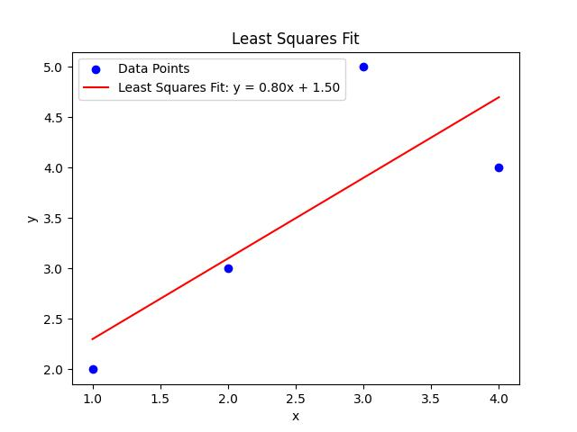
Finding the Best Fit
Given Data Points: (1, 2), (2, 3), (3, 5), (4, 4)
Step 1: Calculate ẋ̄ and ŷ̄:
ẋ̄ = (1 + 2 + 3 + 4) / 4 = 2.5
ŷ̄ = (2 + 3 + 5 + 4) / 4 = 3.5
Step 2: Calculate m and b:
m = 0.8
b = 1.5
Step 3: Line Equation:
y = 0.8x + 1.5

Slide 8
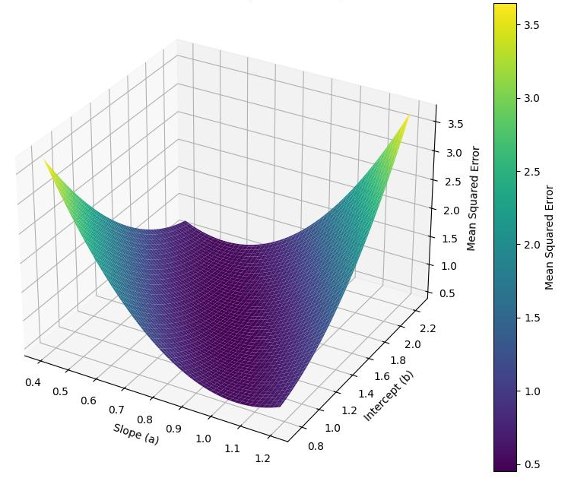
Finding the Best Fit
Given Data Points: (1, 2), (2, 3), (3, 5), (4, 4)
Step 1: Calculate ẋ̄ and ŷ̄:
ẋ̄ = (1 + 2 + 3 + 4) / 4 = 2.5
ŷ̄ = (2 + 3 + 5 + 4) / 4 = 3.5
Step 2: Calculate m and b:
m = 0.8
b = 1.5
Step 3: Line Equation:
y = 0.8x + 1.5

Slide 9
Non-linear Regression
Non-Linear Curve Fitting
Definition: Finding a curve that best fits a set of data points when a straight line is not appropriate.
Theory:
Polynomial Fitting: Use higher-order polynomials (y = a + bx + cx² + ...).
Exponential and Logarithmic Models: Fit data using non-linear functions like y = a * e^(bx) or y = a * log(bx).
Optimization Methods: Use gradient descent or numerical optimization to find the best fit.
Steps to Perform Non-Linear Fitting:
Choose an appropriate model based on data behavior.
Use iterative methods to minimize the error.
Examples:
Fit a sine curve to periodic data such as seasonal temperature variations.
Applications:
Any space where the relationships are non-linear, which is pretty much most areas

Slide 10
Common types of non-linear regresion
Model Types:
Polynomial Fitting: Use higher-order polynomials (y = a + bx + cx² + ...).
Exponential Models: y = a * e^(bx), commonly used for growth models.
Logarithmic Models: y = a * log(bx), often used for decay or diminishing returns.
General Approach:
Choose an appropriate model type.
Use iterative methods (e.g., gradient descent) to minimize the error.
Unlike linear regression, there is no closed-form solution.

Slide 11
Minimizing the error
Objective: Minimize the sum of squared differences between observed values and predicted values.
Mathematical Representation: Minimize ∑(yᵢ - f(xᵢ, θ))², where f(xᵢ, θ) is the non-linear model with parameters θ.
Gradient Descent:
An iterative optimization algorithm used to find the parameters that minimize the error function.
Adjusts parameters by moving in the direction of the negative gradient.

Slide 12
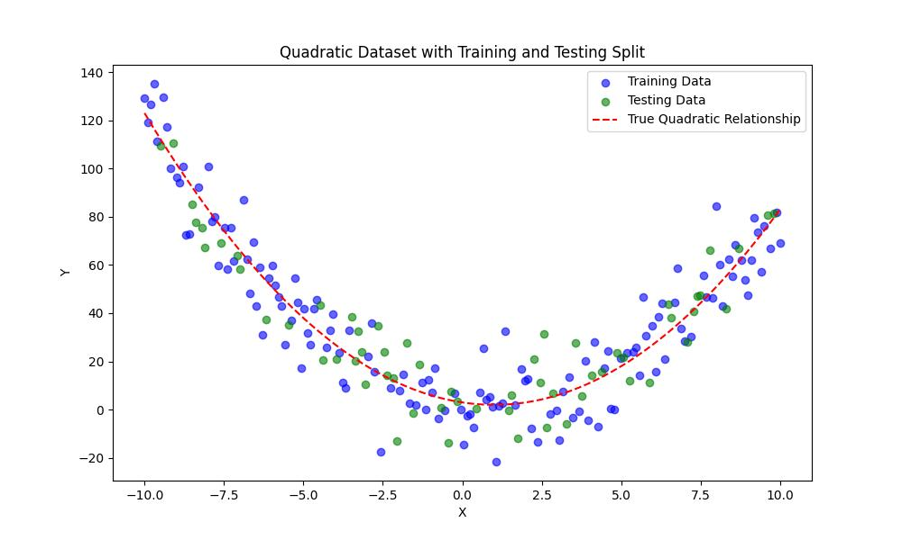
Let’s look at an example
Assume we have a dataset which is a quadratic function with some noise
Split the dataset into training data and testing data
Fit your model using training data, and then test your model using testing data

Slide 13
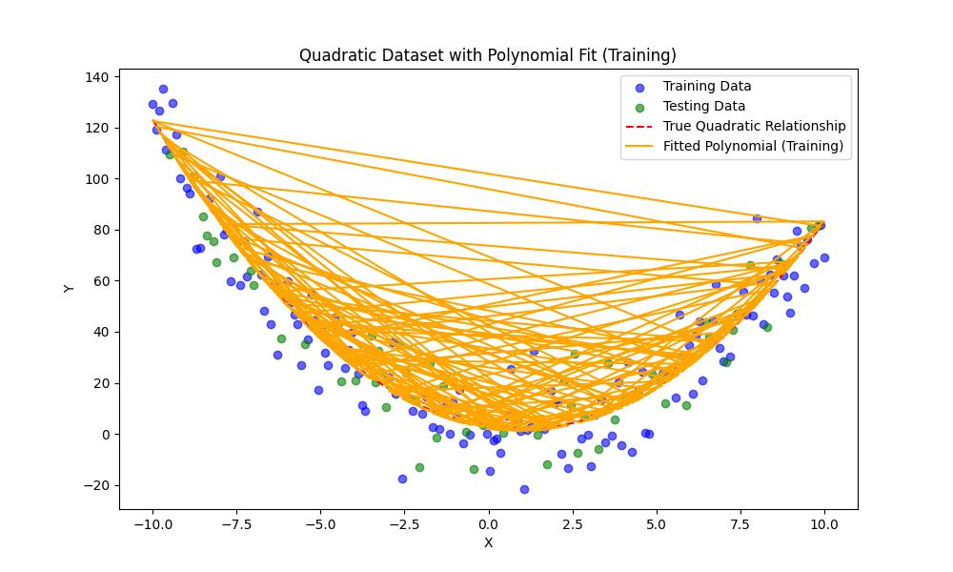
Let’s look at an example
Assume we have a dataset which is a quadratic function with some noise

Slide 14
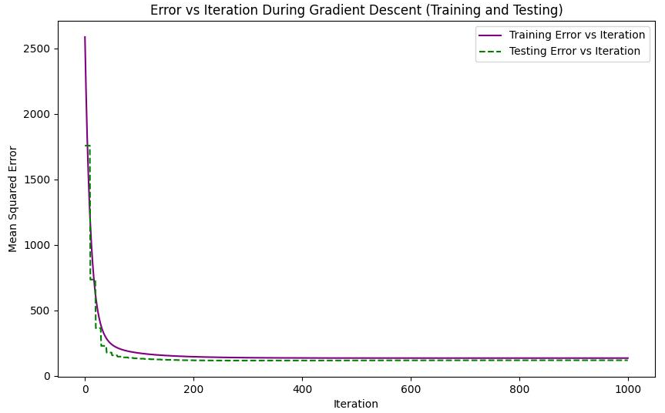
Let’s look at an example
We can see the error during the iterations for both the training set and the testing set

